Slide 1



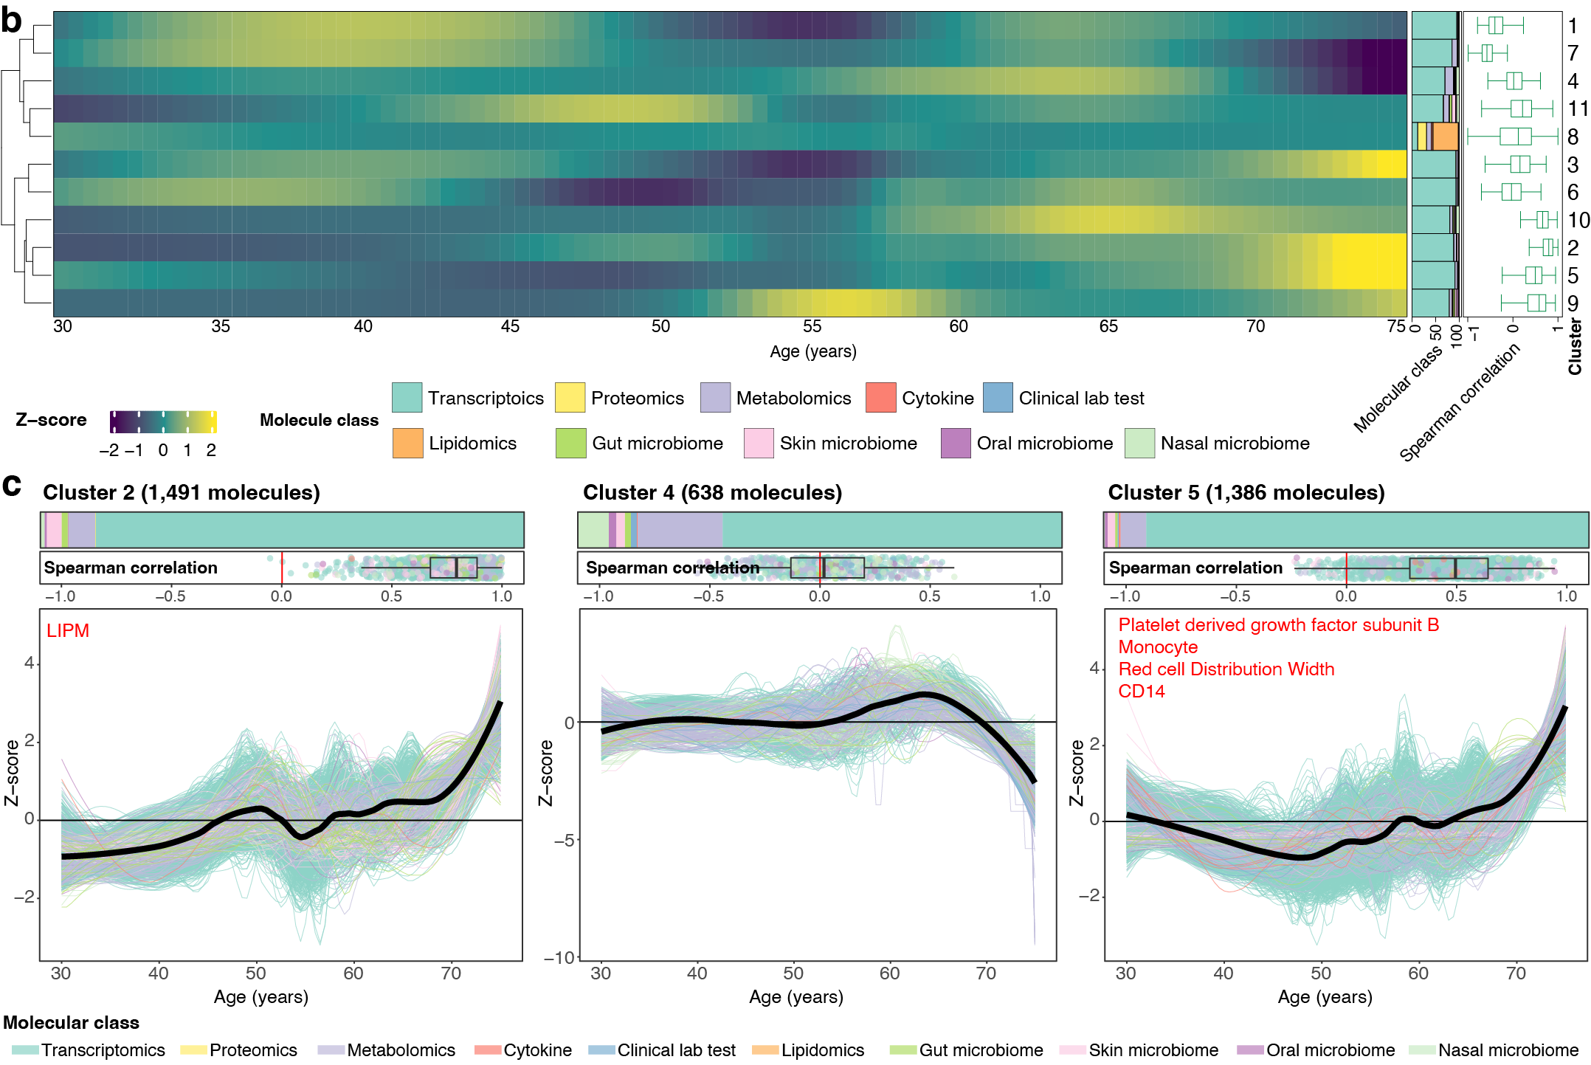
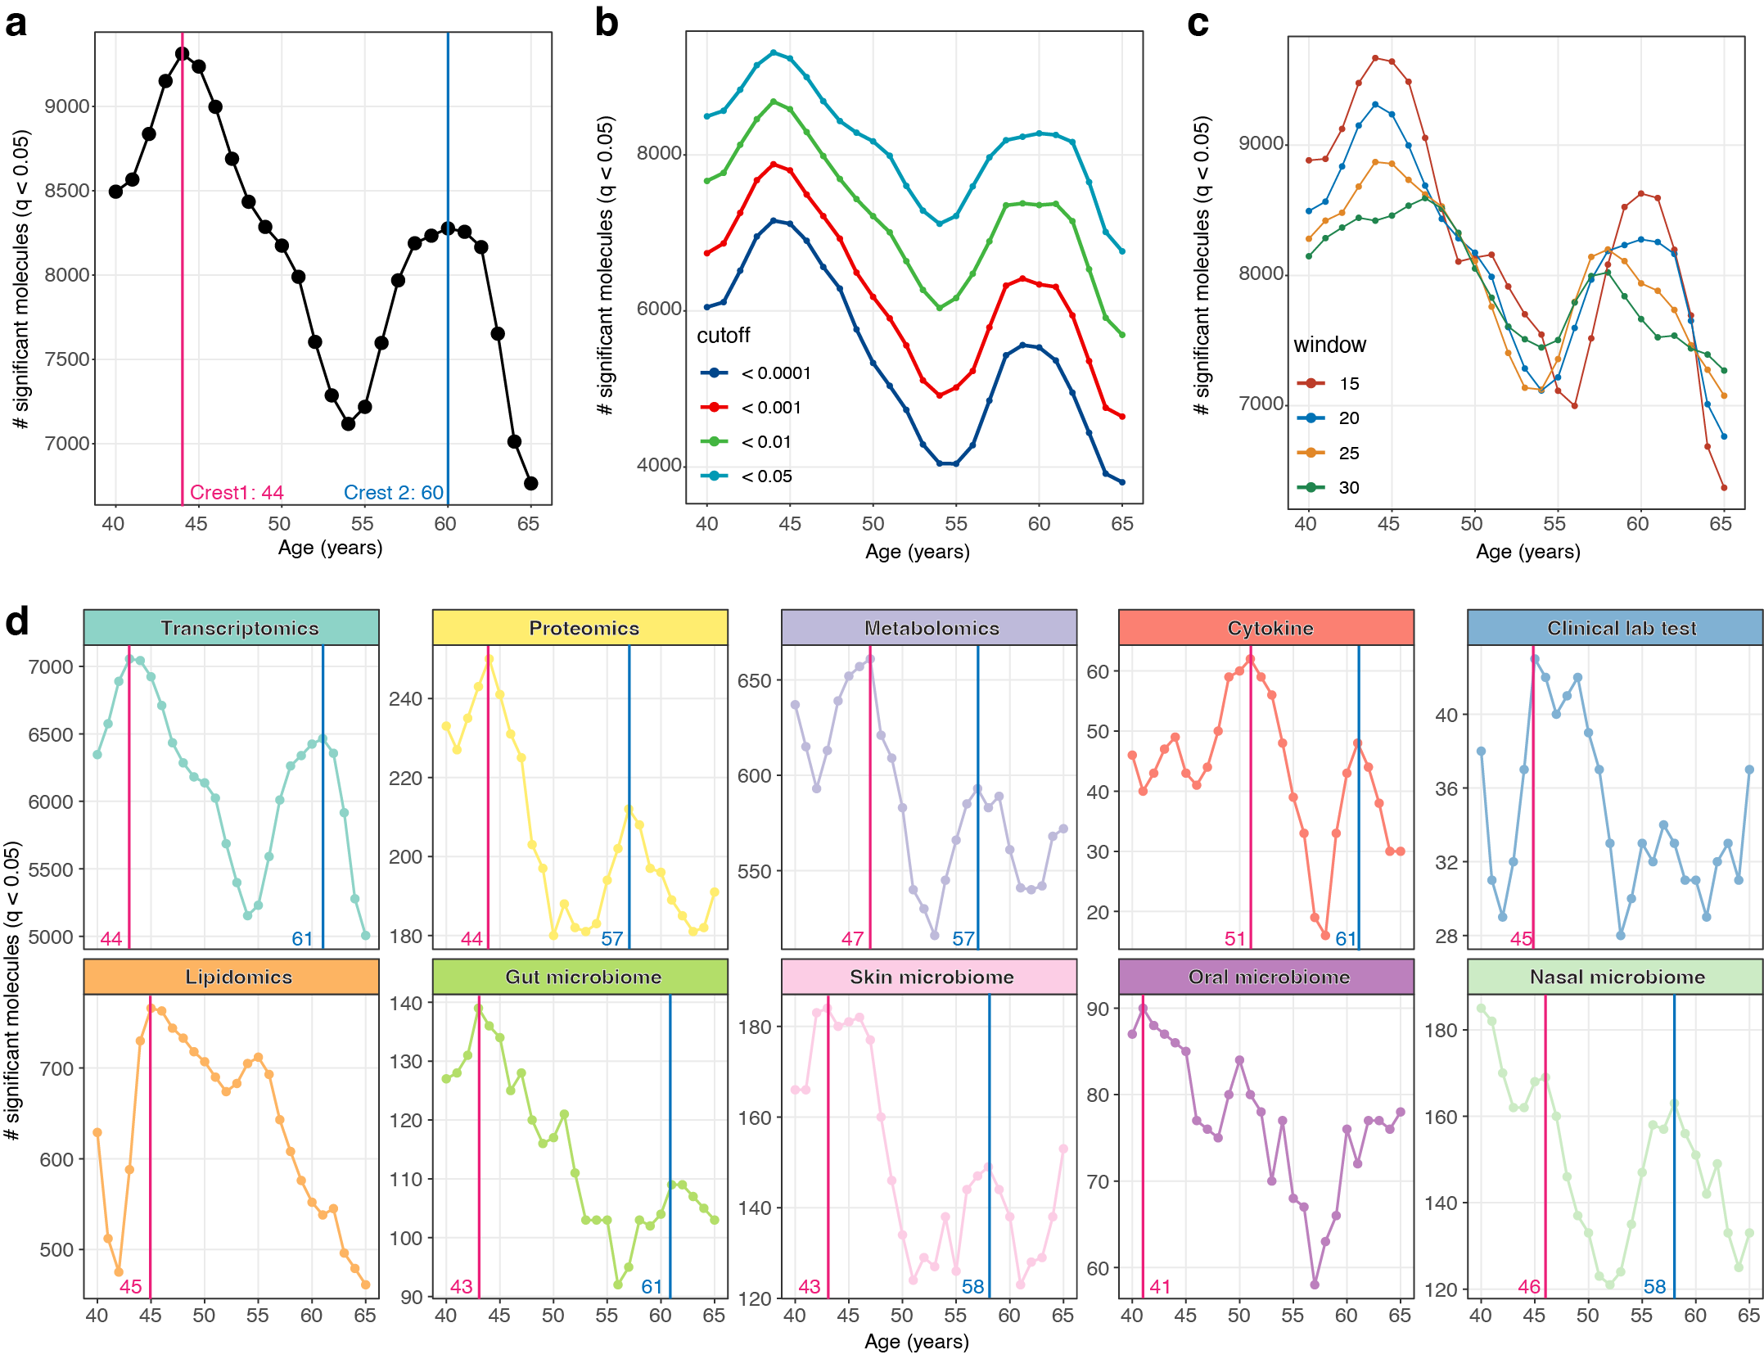
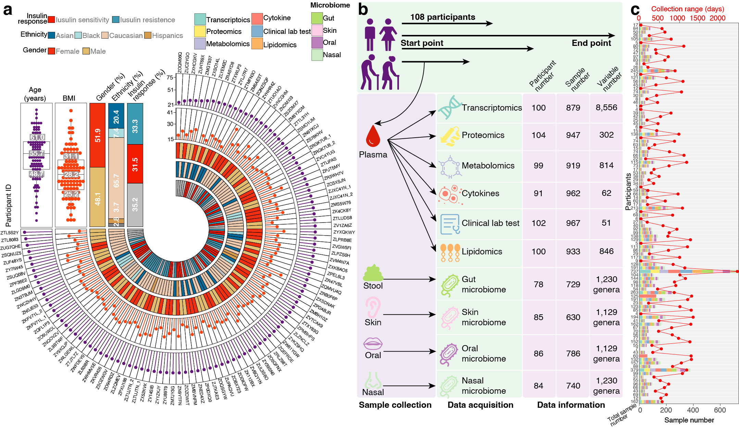
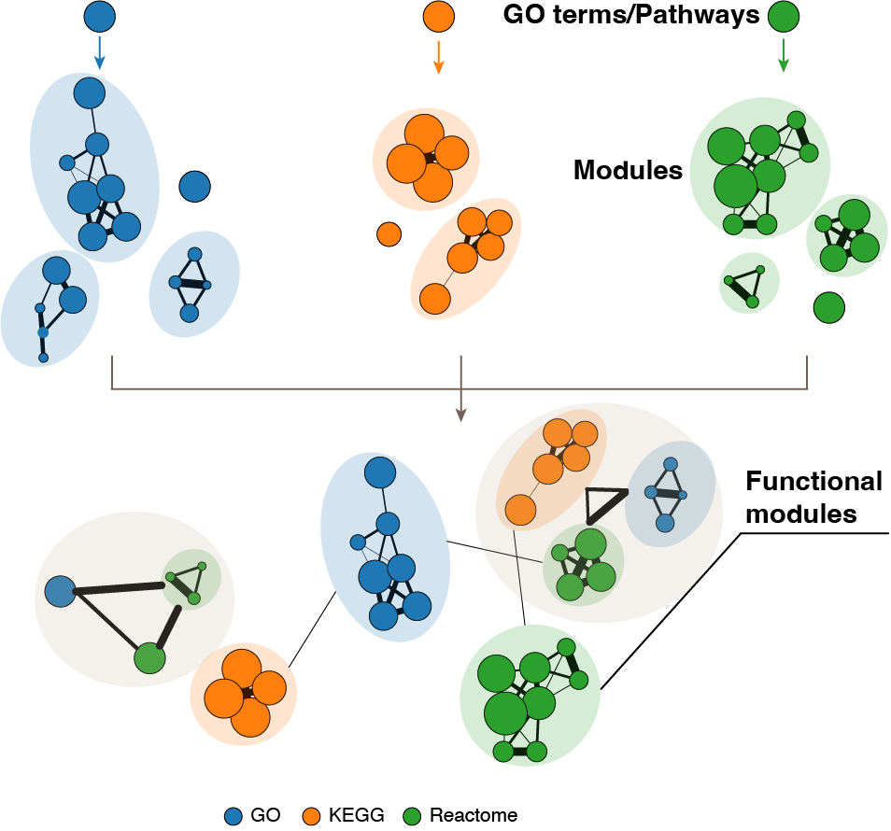
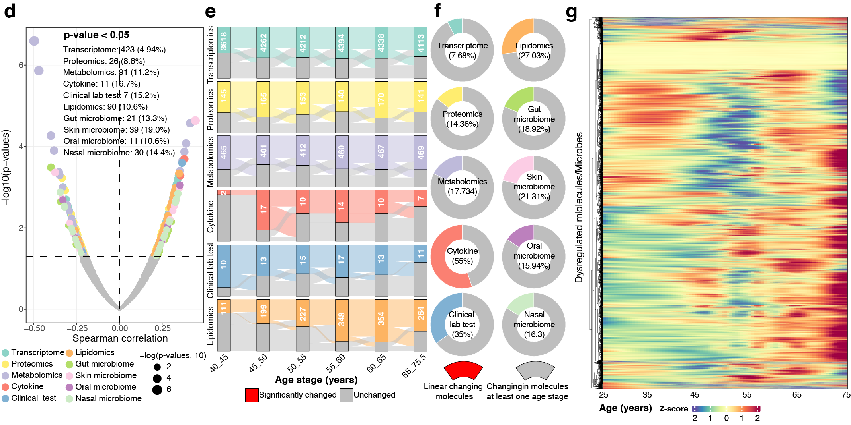
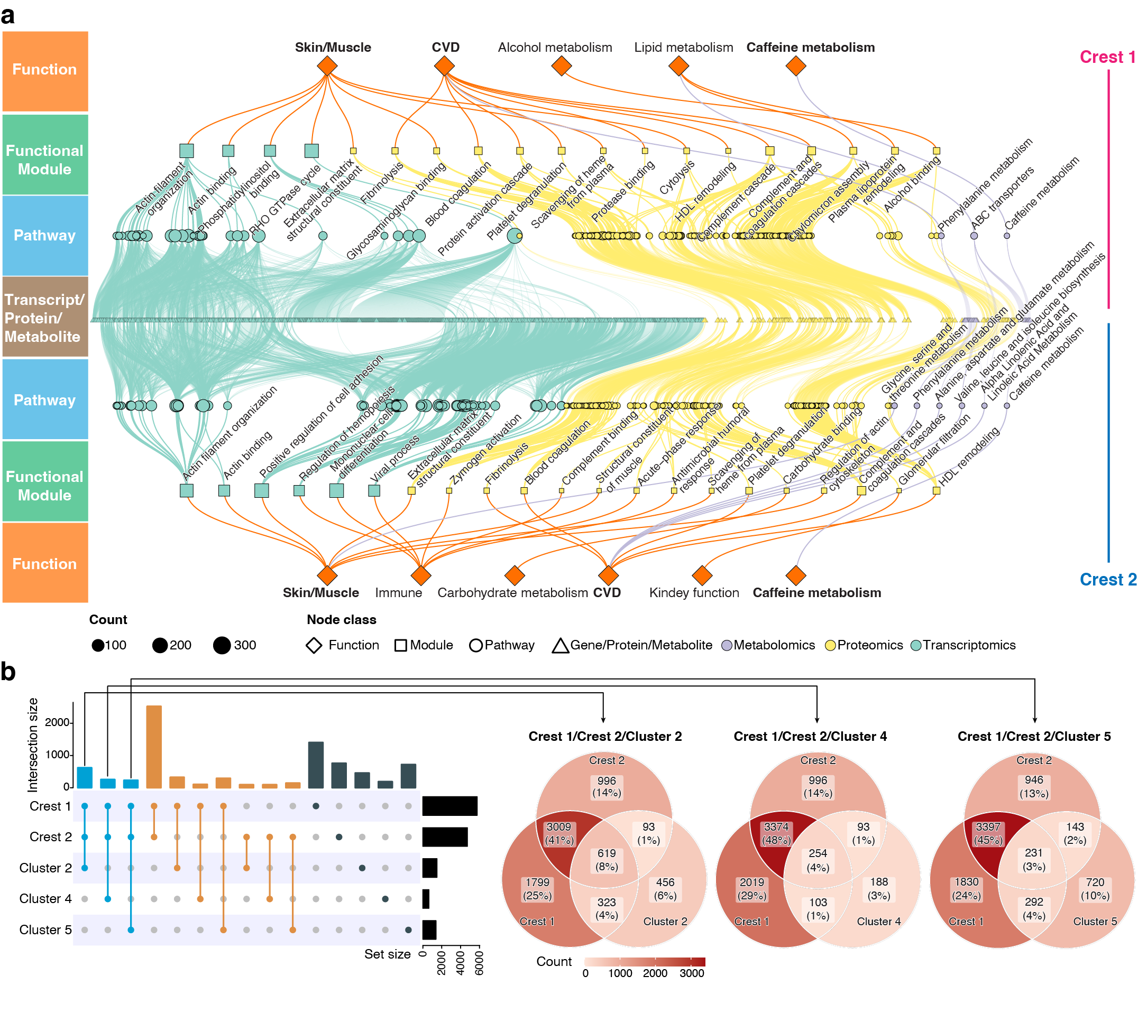
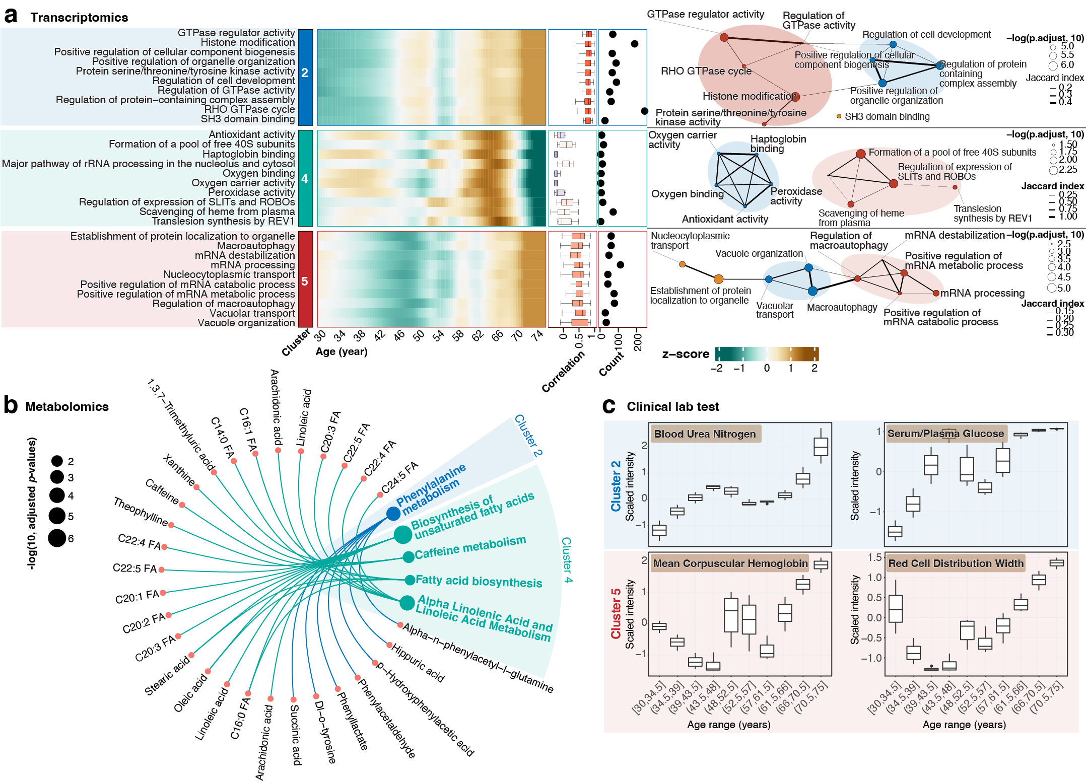
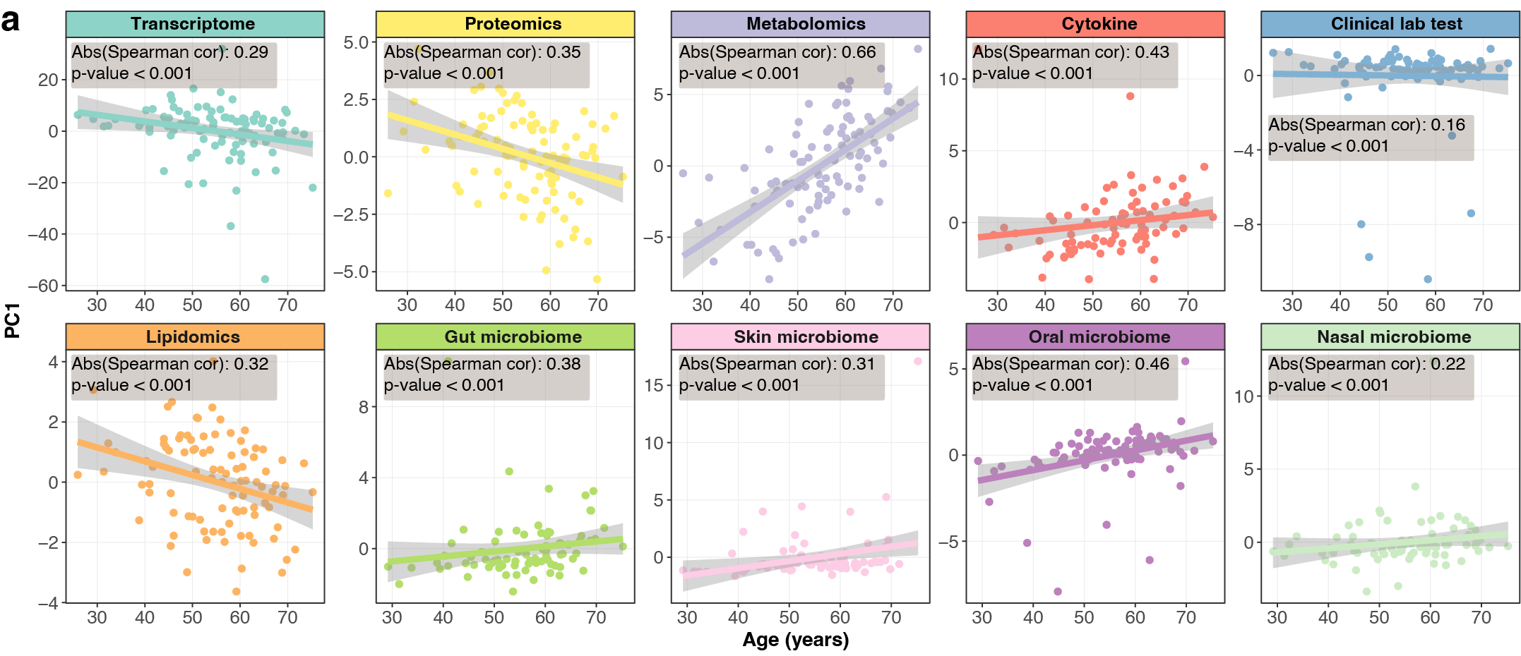
Nonlinear Dynamic Changes During Human Aging Revealed in Multi-omics Profiles
Xiaotao Shen^{1,2,+}, Chuchu Wang^{1,+}, Xin Zhou¹, Wenyu Zhou¹, Daniel Hornburg¹, Si Wu¹, Michael Snyder^{1*}
¹Stanford University School of Medicine.
²Lee Kong Chian School of Medicine, Nanyang Technological University, Singapore
⁺Co-first author. *Corresponding author
Abstract
Understanding the molecular changes underlying aging and identifying therapeutic targets for aging-related diseases is crucial for increasing health span. While many studies have explored linear changes during aging, the prevalence of aging-related diseases and mortality risk accelerates after specific time points, indicating the importance of studying nonlinear molecular changes. We conducted deep multi-omics profiling of a longitudinal human cohort aged 25 to 75 years. The analysis revealed consistent nonlinear patterns in molecular markers of aging, with significant dysregulation occurring at two major periods occurring at approximately 40 and 60 years of chronological age. Functional pathways associated with these nonlinear changing molecules, such as immune regulation and carbohydrate metabolism, were also identified during the 60-year transition, indicating that functions and risks of aging-related diseases change nonlinearly across the human lifespan. Overall, this research provides significant biological insights through the global monitoring of nonlinear molecular changes during human aging.
Clustering reveals nonlinear changes in multi-omics profiling during human aging
Uncovering waves of aging-related molecules and microbes across the human lifespan
Study design
Module annotation of enriched pathway analysis results (MAPA)
Functional analysis of aging-related waves of molecules across the human lifespan
Most of the molecules/microbes change nonlinearly during human aging
Nonlinear alterations in function and disease risk during the aging process
Multi-omics data could serve as reliable indicators of the aging process
Acknowledgments
We express our sincere gratitude to all the research participants in this study. We would also like to thank Mrs. Ada Yee Ki Chen and Mrs. Lisa Stainton for their valuable administrative assistance. We are deeply grateful to Dr. Axel Brunger for his insightful comments. The NIH grants and the Stanford Data Science Initiative supported this work.

Slide 2

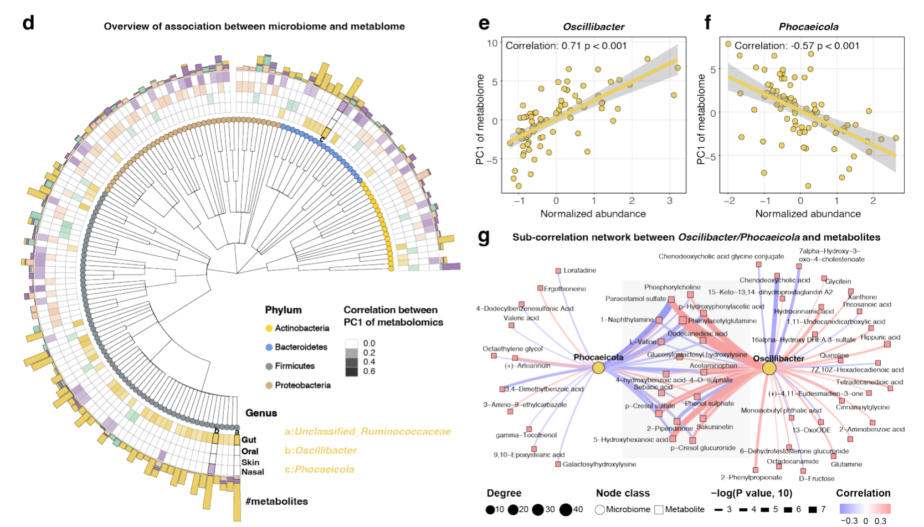
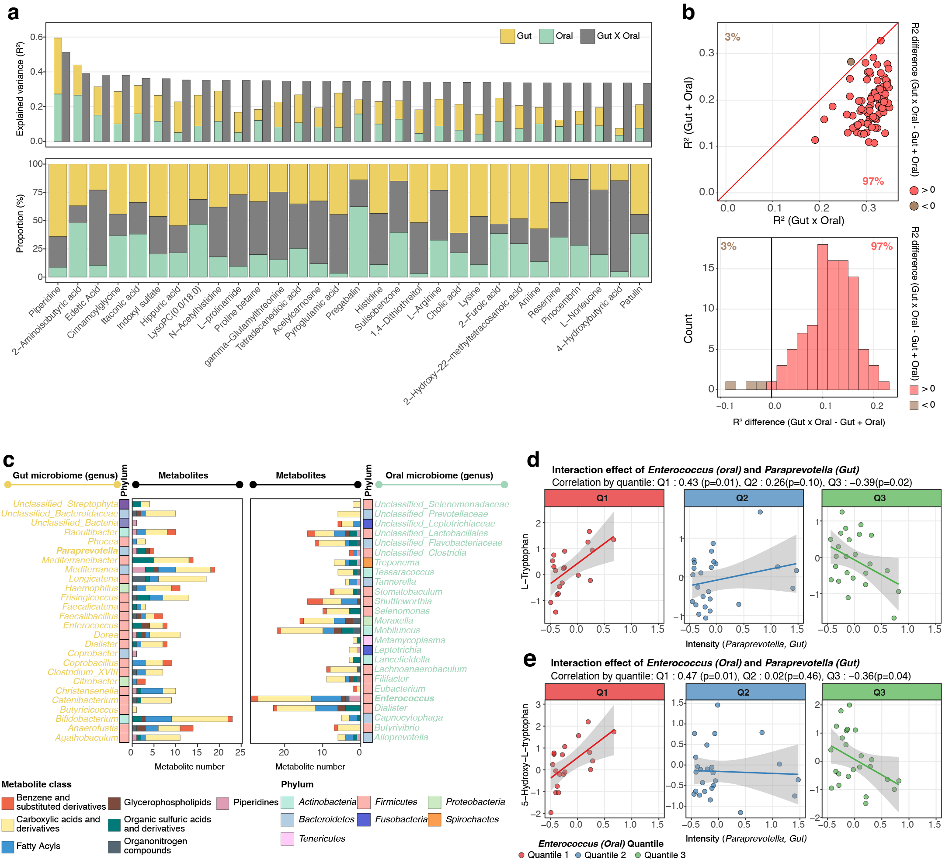
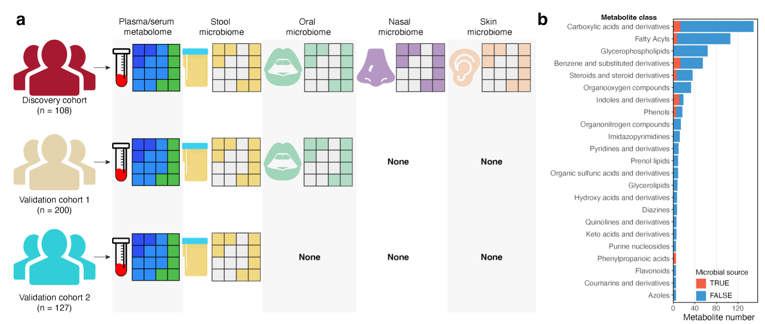
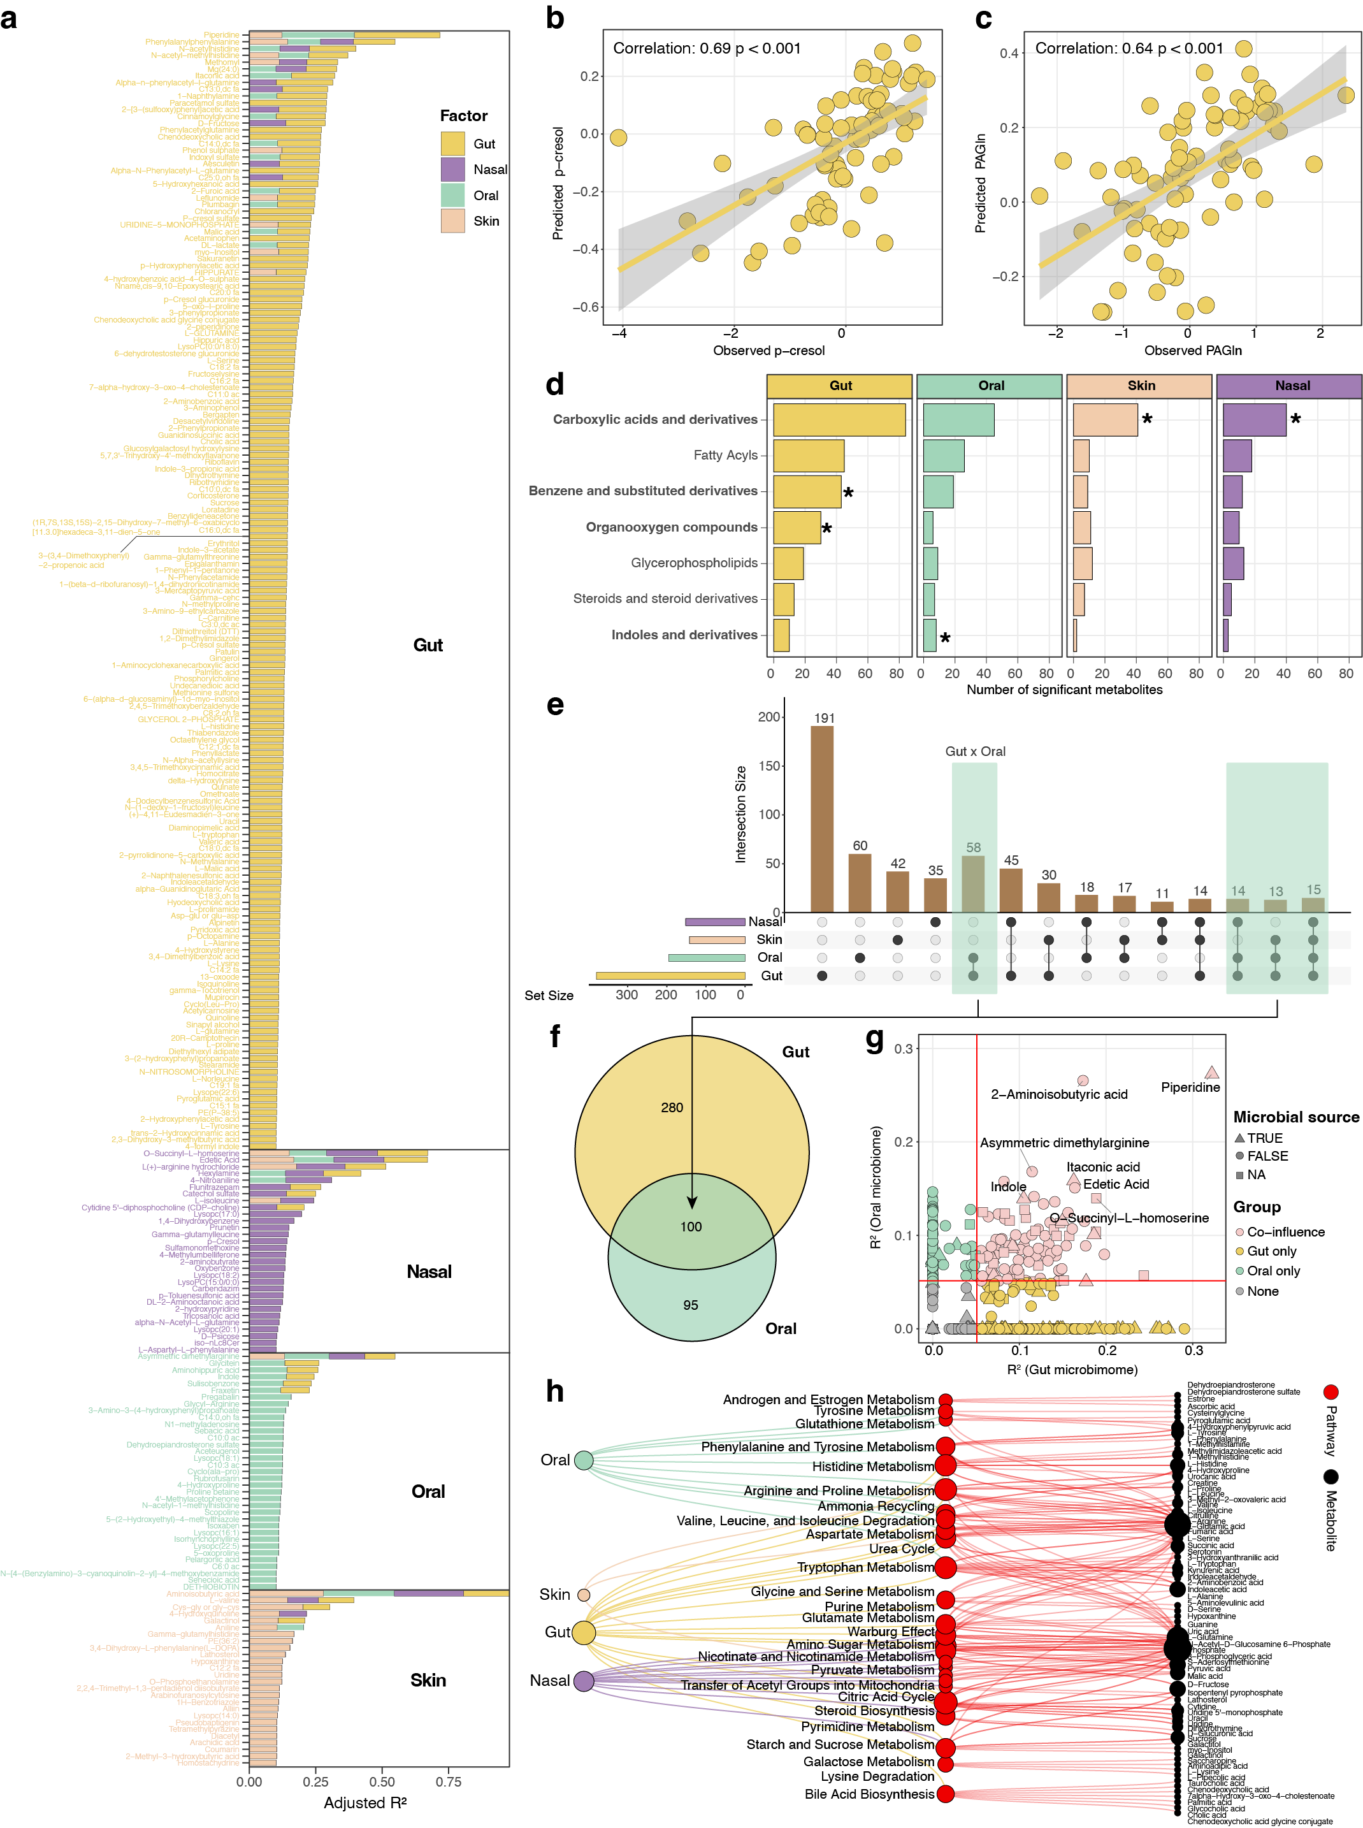
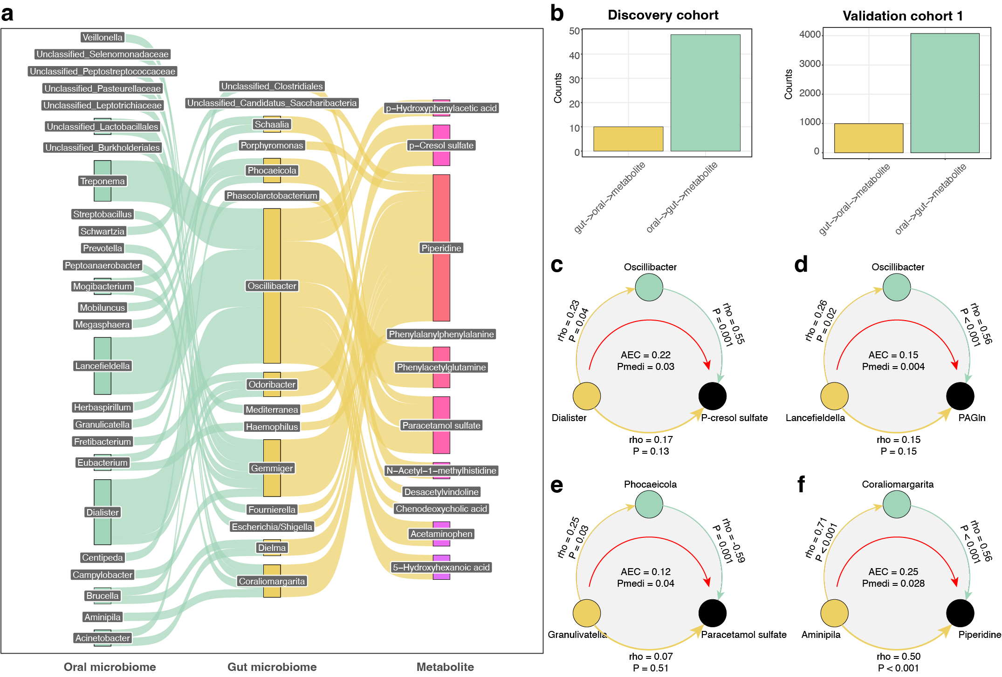
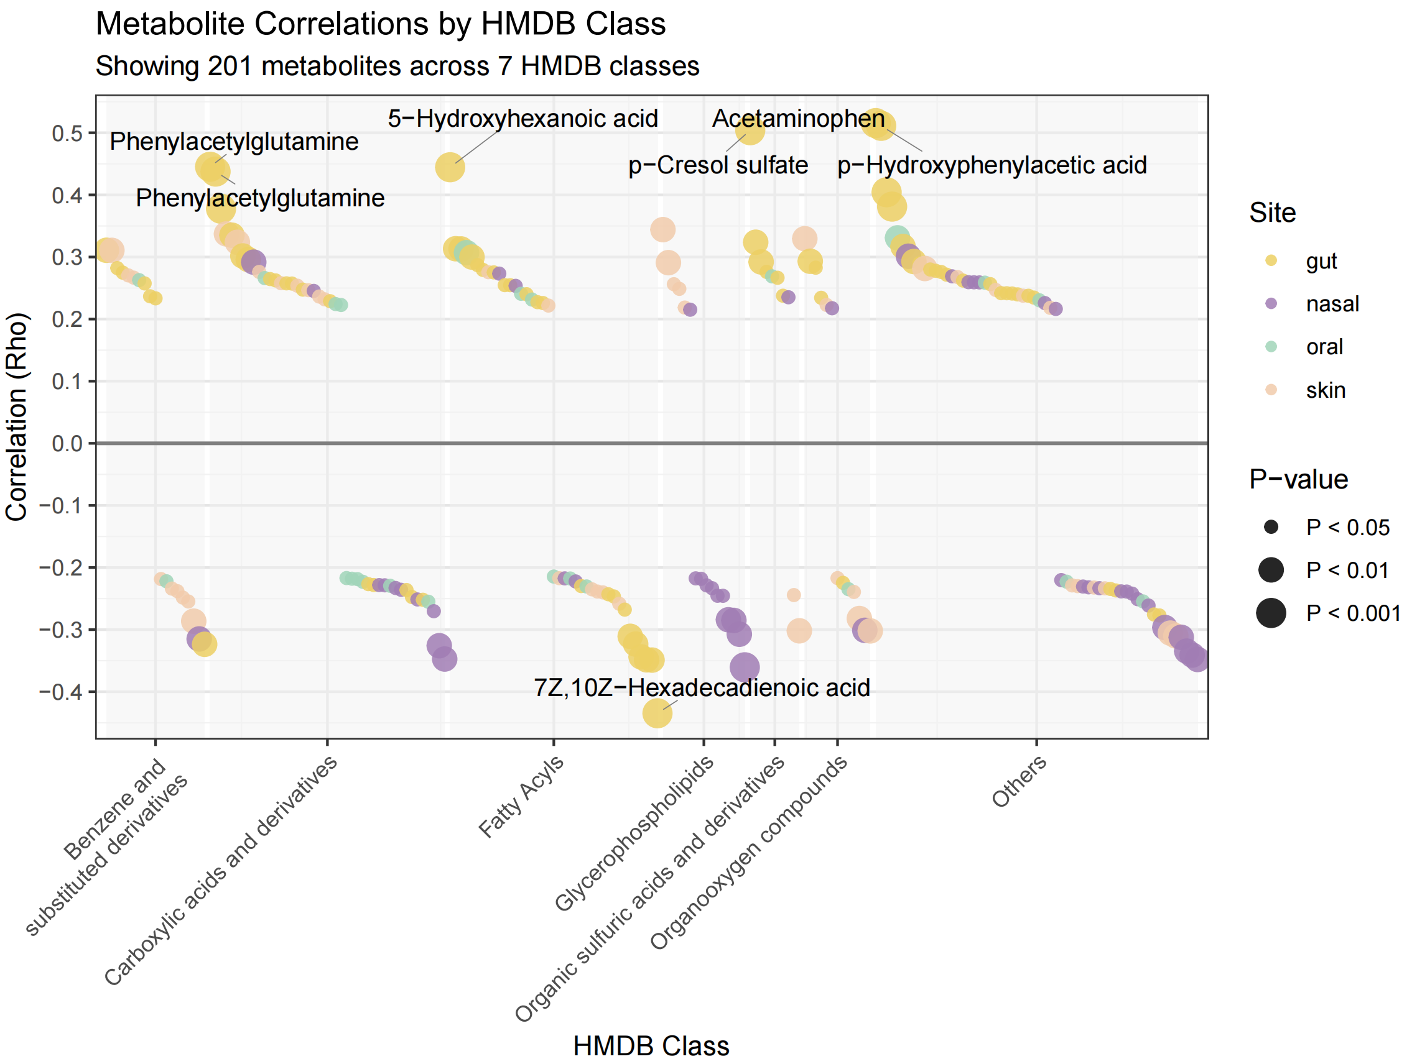
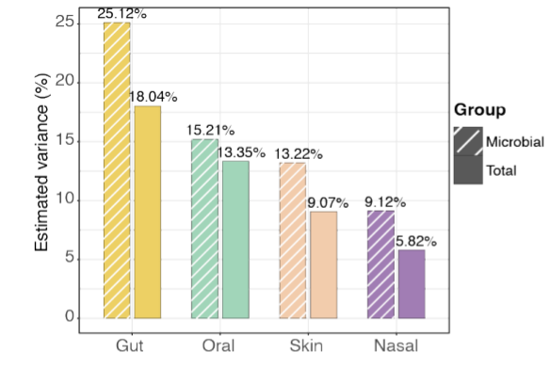
The Comprehensive Effects of Multi-site Microbiome on Plasma Metabolome
Jingxiang Zhang^{1,2}, Sunny Wong¹, Chao Jiang, Xiaotao Shen^{1,2,3*}
Lee Kong Chian School of Medicine, Nanyang Technological University, Singapore, Singapore.
School of Chemistry, Chemical Engineering and Biotechnology, Nanyang Technological University, Singapore, Singapore.
Singapore Phenome Center, Nanyang Technological University, Singapore, Singapore.
Abstract
Circulating metabolites in human blood are critical for the health of various organs throughout the body. Current research has established that blood metabolites are influenced by a combination of host genetics, diet, and gut microbiota, with the gut microbiome playing a particularly crucial role. Beyond the gut microbiome, humans harbor diverse microbial communities at other sites, including the oral cavity, skin, and respiratory tract. However, whether these different microbial communities collectively shape the blood metabolome remains unclear.To address this knowledge gap, we investigated the combined influence of microbiomes from four body sites (gut, oral cavity, skin, and nasal cavity) on the plasma metabolome using the iPOP cohort. Most of the significant associations we identified were subsequently validated in external datasets. Our results demonstrate that the plasma metabolome is collectively influenced by microbial communities from all four body sites, with multiple metabolites strongly correlated with microbial diversity.Further analysis revealed that the gut microbiome exerts a stronger influence on plasma metabolites compared to the other three body sites, showing particularly robust associations with microbially-derived metabolites (such as p-cresol and PAGln). Importantly, we identified numerous metabolites jointly influenced by both gut and oral microbiomes, particularly those involved in tryptophan and phenylalanine metabolic pathways. Significant interaction and mediation effects were observed between oral and gut bacteria on these metabolites. These findings elucidate the intimate connections between human microbiomes and the circulating metabolome, as well as the systematic characteristics of how microbiomes from different body sites influence metabolites.
Study Design
We collected 3 hon

